Slide 1
MEALY TO MOORE COVERSION
&
MOORE TO MEALY CONVERSION
GROUP MEMBERS:
22K-4465
22K-4211
22K-4556

Slide 2
TABLE OF CONTENTS
01
02
03
04 CONCLUSION
INTRODUCTION
MEALY TO MOORE
MOORE TO MEALY

Slide 3
INTRODUCTION

Slide 4
INTRODUCTION
Mealy and Moore machines are types of finite state machines used in digital systems.
Mealy machines produce outputs based on both their current state and the inputs, while Moore machines produce outputs based only on their current state.
The project aims to provide a practical and efficient solution for digital system designers to seamlessly transition between Mealy and Moore machine implementations.

Slide 5

MEALY TO MOORE

Slide 6
MEALY TO MOORE CONVERSION DESCRIPTION
1. INPUT MEALY TABLE
Basically we enter the values of the mealy table in integer value numbers. If there is a state with 0 in it we don’t write it.
State | Input 0 | Output 0 | Input 1 | Output 1
Input Example:
1 Or 1 1 2 3 4
1
2
3
4
2. VARIABLES
1 Mealy Machine Table
1 Moore Machine Table
1 Output Encoding States Status
1 Total Old + New states
Flags

Slide 7
MEALY TO MOORE CONVERSION DESCRIPTION
3. OUTPUT ENCODING
We first check if there is need to create new states, if so we add 1 to the specific state status array.
Next we add up the status array to see how many total states we have.
Finally we can find out how many new states were created.
4. ASSIGNMENT OF NEW STATES
Basic understanding needed here as a state has two outputs (Our Case Has To But You Change That) towards it in the process.
The new states will have a new value of (10*previous_state_value)+For_which_Ouput_Its_Made;
Example:
10*2+1 Or 10*2+0
5. MEALY TABLE
The new mealy table is created first.
6. MOORE TABLE
The corresponding moore table is created.

Slide 8
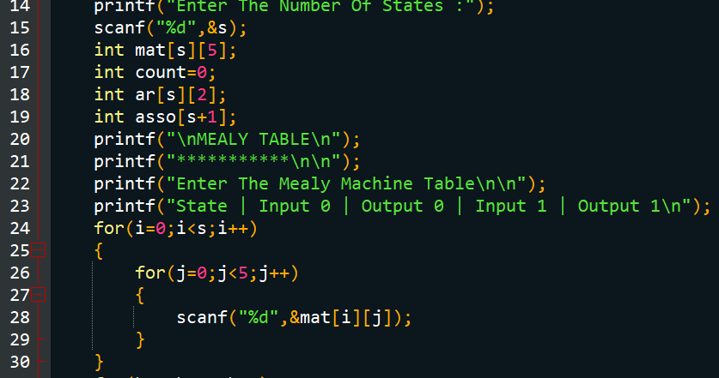
MEALY TO MOORE CODE SNIPPETS:
Prompting The User To Input Mealy Machine Table. (State Cannot Be Zero)

Slide 9
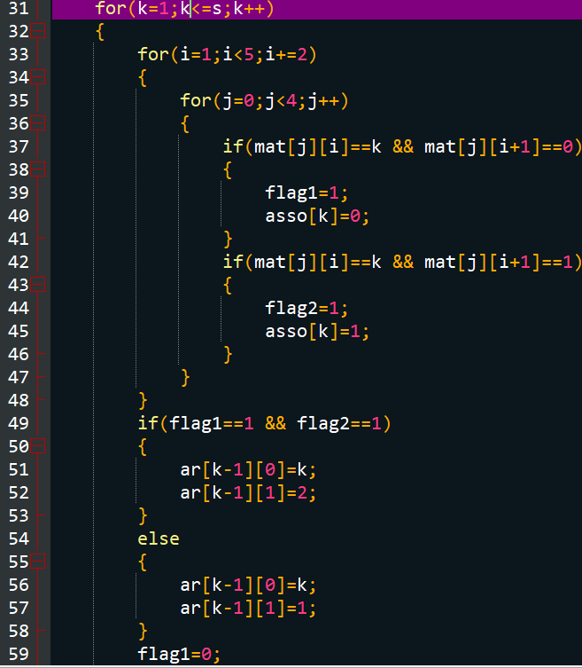
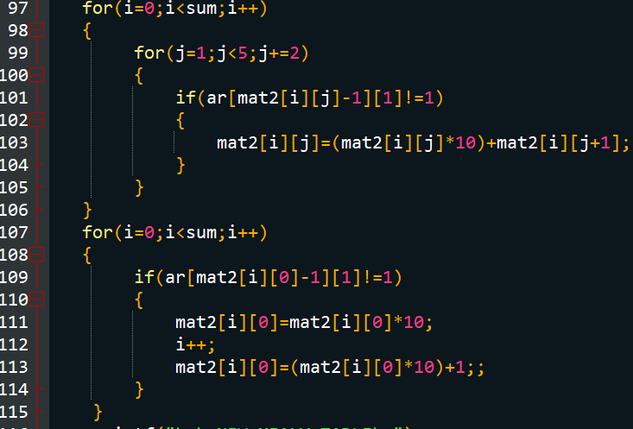
MEALY TO MOORE CODE SNIPPETS:
Determination Of Any New State Outputs
Creation Of New States

Slide 10
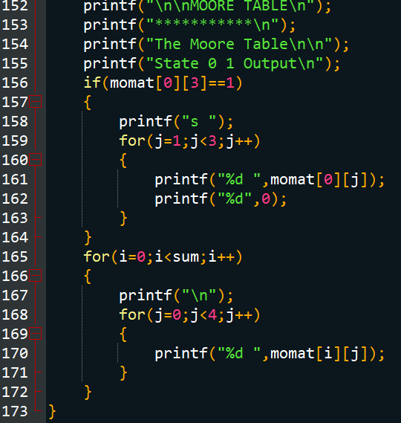
MEALY TO MOORE CODE SNIPPETS
Displaying The Moore Machine Table

Slide 11
MOORE TO MEALY

Slide 12
MOORE TO MEALY CONVERSION DESCRIPTION
1. INPUT MOORE TABLE
Basically we enter the values of the moore table in integer value numbers. If there is a state with 0 in it we can write it.
State | 0 | 1 | Output
Input Example:
1 Or 1 1 2 3 4
1
2
3
4
2. WORKING
It goes to the inputs 0 and 1 destinations state.
Enters the outputs of the destination state in the single moore array.

Slide 13
MOORE TO MEALY CONVERSION DESCRIPTION
3. VARIABLES
Single moore input array which is also used to display the mealy table.
4. MEALY TABLE
The corresponding mealy table is created.

Slide 14
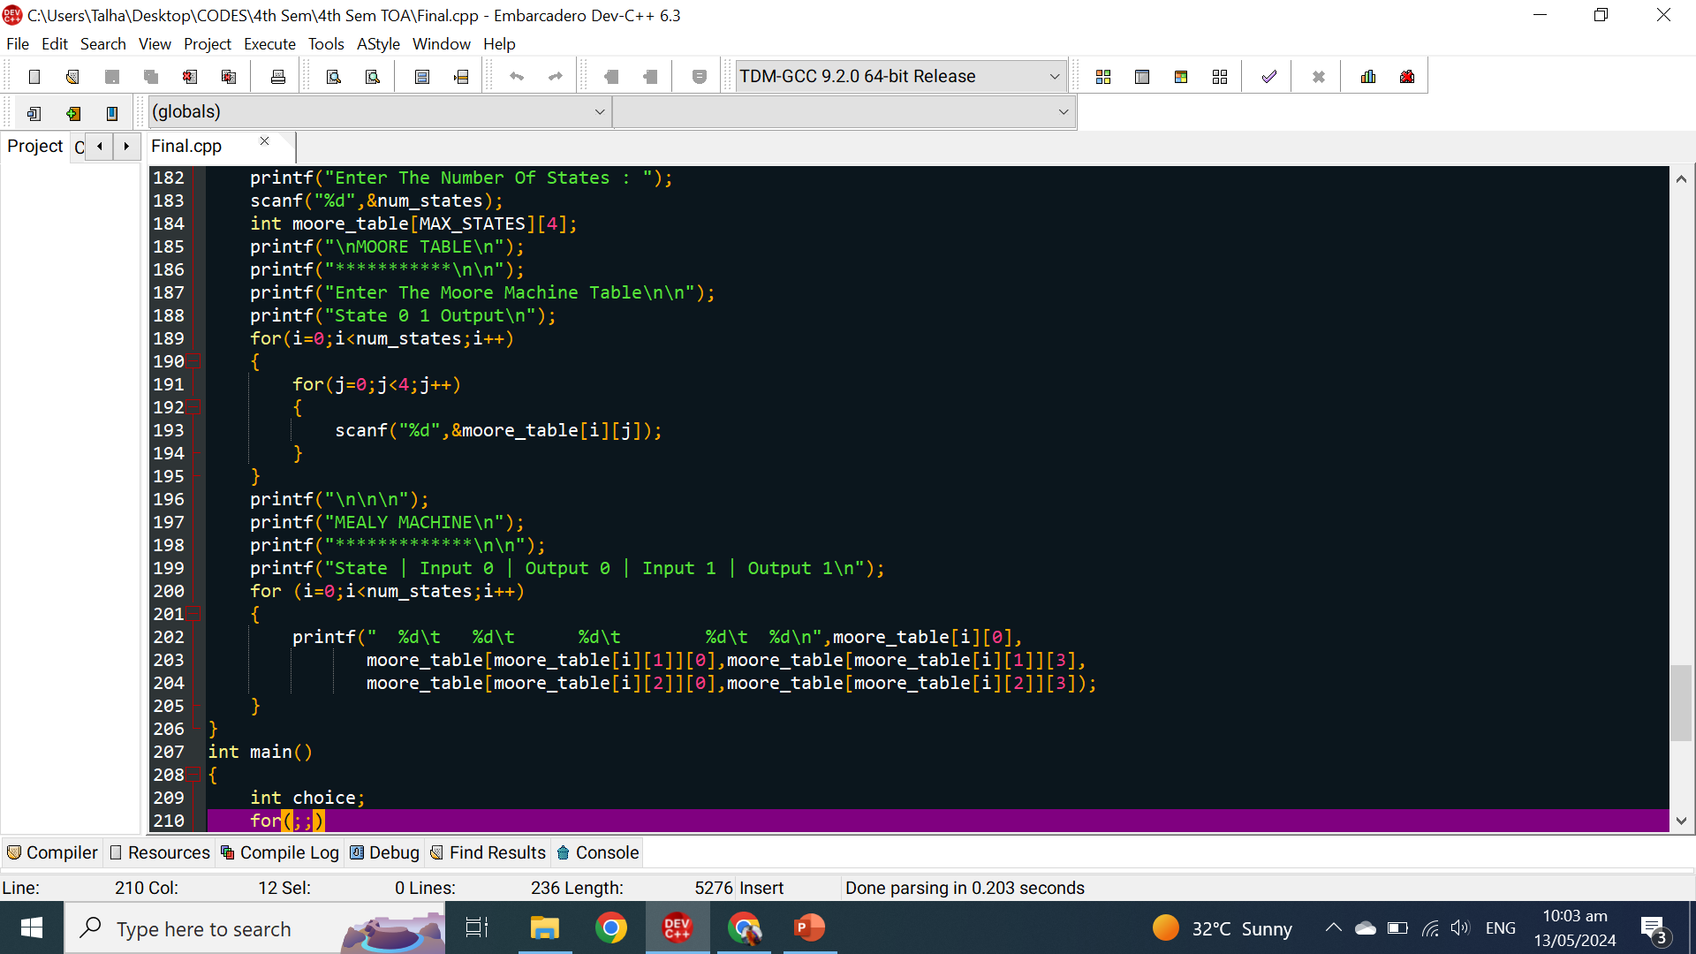
MOORE TO MEALY CODE SNIPPETS:
Prompting The User To Input The Moore Machine Table (State Can Be Zero)

Slide 15
MOORE TO MEALY CODE SNIPPETS:
Converting From Moore To Mealy And displaying The New Table

Slide 16
CONCLUSION
The developed coversion tool holds significant potential for various applications in digital system design and optimization.
This tool facilitates efficient exploration of different machine types, enabling designers to adapt to specific design requirements and constraints effectively.

Slide 17
THANKS!

